Slide 1
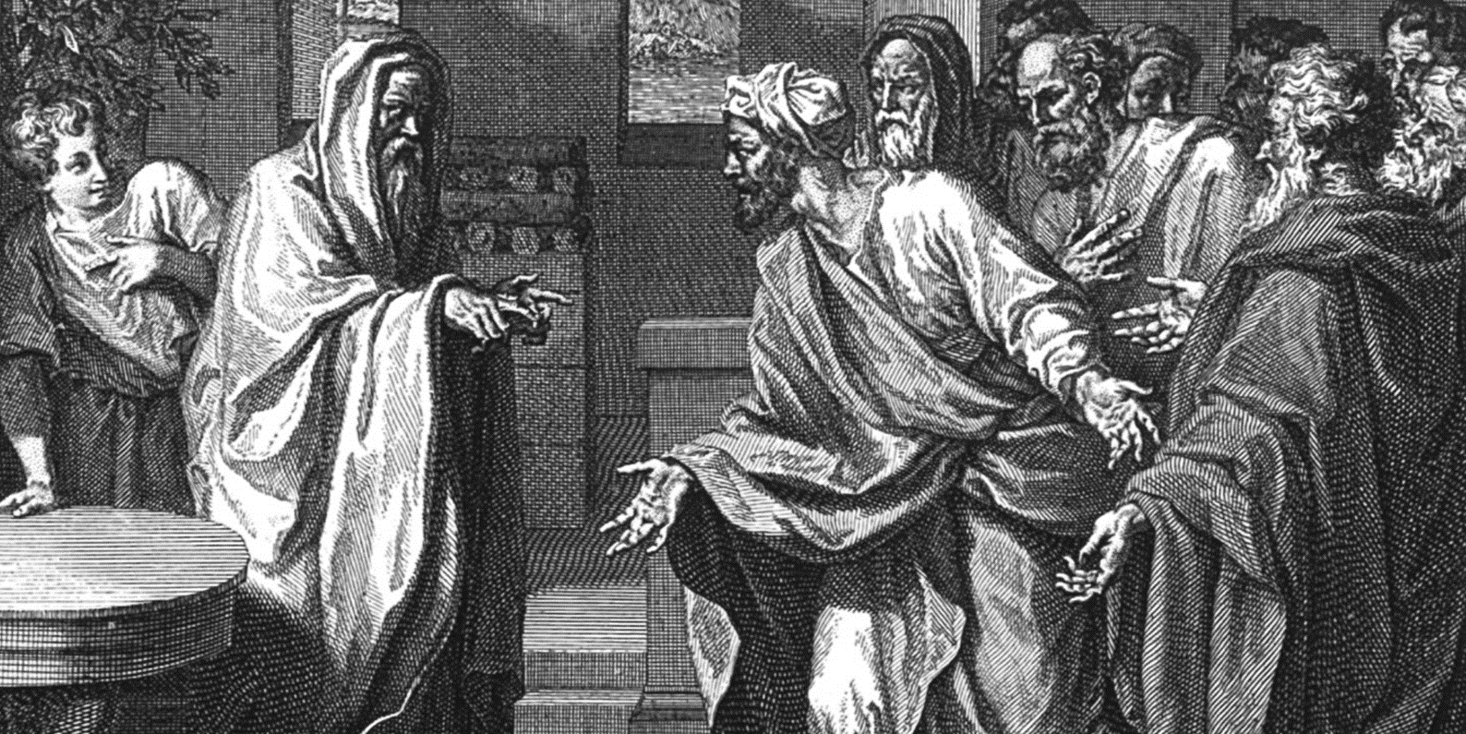

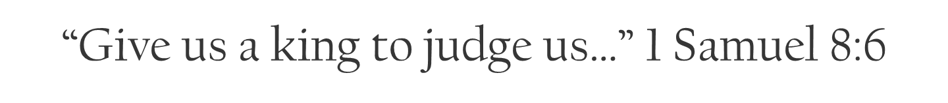

Slide 2
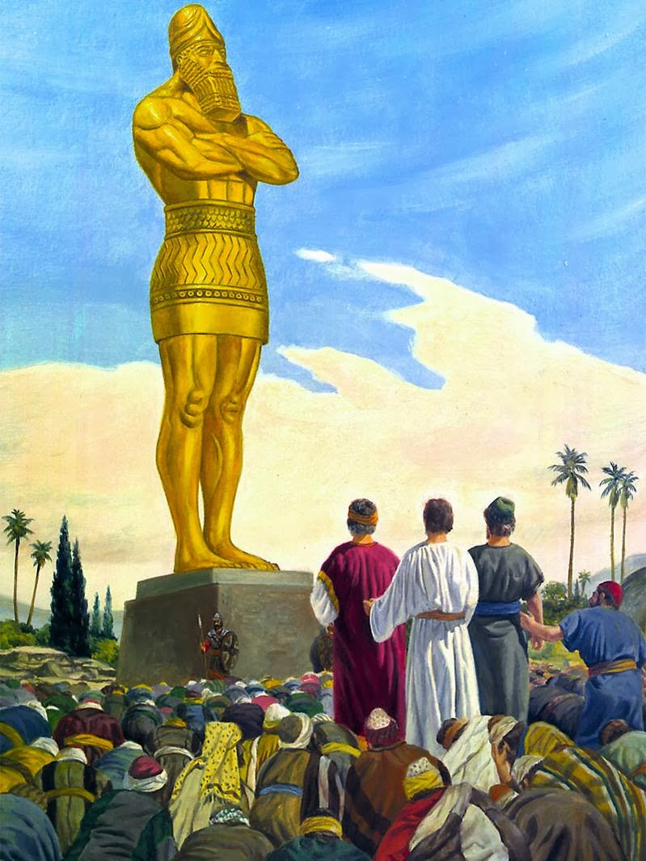
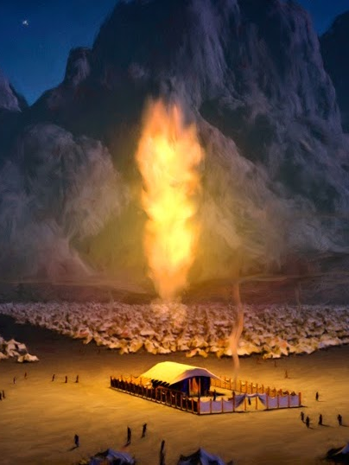
Everywhere else in the ancient world, the king was a god. In Israel, God was king.

Slide 3
John 18:38-40 Pilate saith unto him, What is truth? And when he had said this, he went out again unto the Jews, and saith unto them, I find in him no fault at all. 39 But ye have a custom, that I should release unto you one at the passover: will ye therefore that I release unto you the King of the Jews? 40 Then cried they all again, saying, Not this man, but Barabbas. Now Barabbas was a robber.

Slide 4
Anytime we run to the world for solutions, we short ourselves by shutting God out.
Replacing the rule of God for that of man will COST YOU far more than you can ever afford!

Slide 5
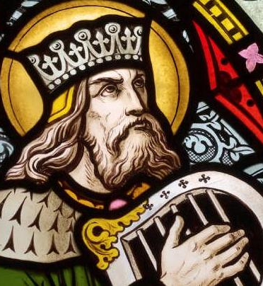
God knew that Israel would need a king; but they needed one in the proper time.
God had a king in mind, but it wasn’t time for God’s plan and his man David to be revealed.
A future king was prophesied to Abraham, Sarah and Jacob!

Slide 6
Genesis 17:6 And I will make thee exceeding fruitful, and I will make nations of thee, and kings shall come out of thee.
Genesis 17:16 And I will bless her, and give thee a son also of her: yea, I will bless her, and she shall be a mother of nations; kings of people shall be of her.
Genesis 35:11 And God said unto him, I am God Almighty: be fruitful and multiply; a nation and a company of nations shall be of thee, and kings shall come out of thy loins;

Slide 7
The provisions of God come in God’s time!

Slide 8
1 Timothy 6:17 Charge them that are rich in this world, that they be not highminded, nor trust in uncertain riches, but in the living God, who giveth us richly all things to enjoy;

Slide 9
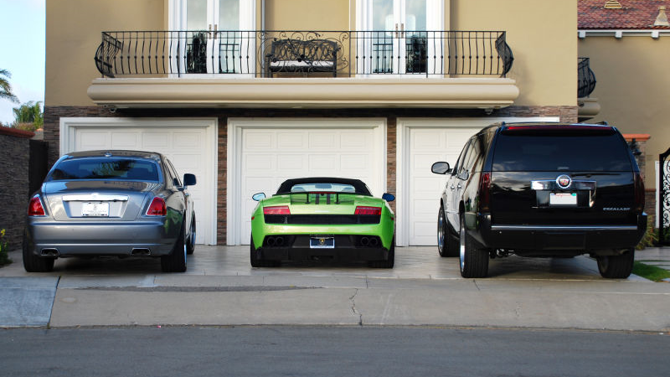
Stuff in life.

Slide 10

Sex for enjoyment.
God designed sexual pleasure
for mankind. Timing? Marriage
Hebrews 13:4 Marriage is honourable in all, and the bed undefiled: but whoremongers and adulterers God will judge.

Slide 11
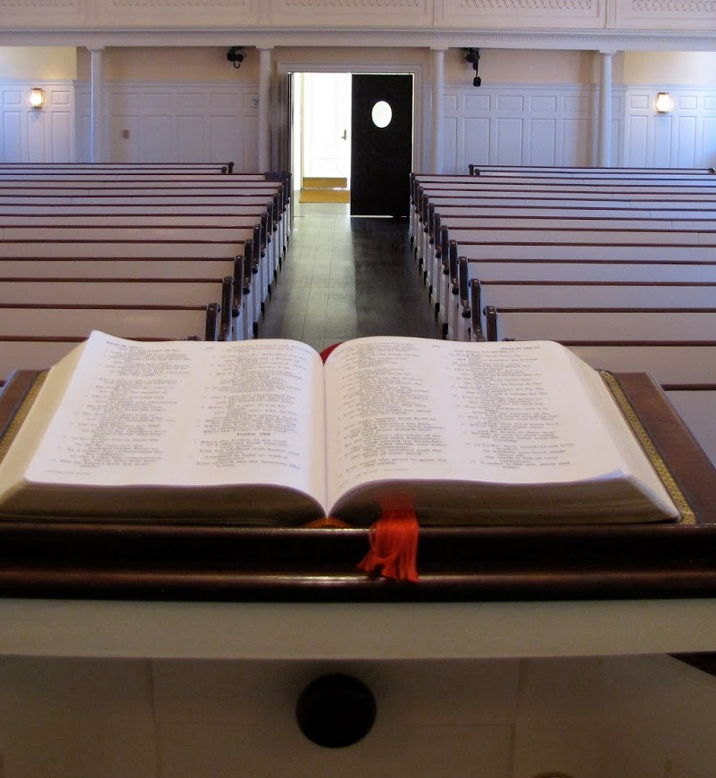
Stature in ministry.
1 Timothy 3:1 This is a true saying,
If a man desire the office of a bishop,
he desireth a good work.
1 Corinthians 4:1-2 Let a man so
account of us, as of the ministers of
Christ, and stewards of the mysteries of
God. 2 Moreover it is required in stewards,
that a man be found faithful.
Luke 16:10 10 He that is faithful in that which is least is faithful also in much: and he that is unjust in the least is unjust also in much.

Slide 12
Impatience - wanting what God has, on
your terms, in your time results in disaster.

Slide 13
Genesis 3:4-5 And the serpent said unto the woman, Ye shall not surely die: 5 For God doth know that in the day ye eat thereof, then your eyes shall be opened, and ye shall be as gods, knowing good and evil.

Slide 14

Whatever you get in life, you PAY FOR!
IF you buy into the way the WORLD does life, then you better believe that the world will OWN YOU!
What does doing life the worlds way cost you?
  Your family!
  Your finances.
How does doing life the world’s way crush you?
  Your failure.

Slide 15
Galatians 6:7-8 Be not deceived; God is not mocked: for whatsoever a man soweth, that shall he also reap. 8 For he that soweth to his flesh shall of the flesh reap corruption; but he that soweth to the Spirit shall of the Spirit reap life everlasting.

Slide 16
Matthew 24:24 For there shall arise false Christs, and false prophets, and shall shew great signs and wonders; insomuch that, if it were possible, they shall deceive the very elect.

Slide 17
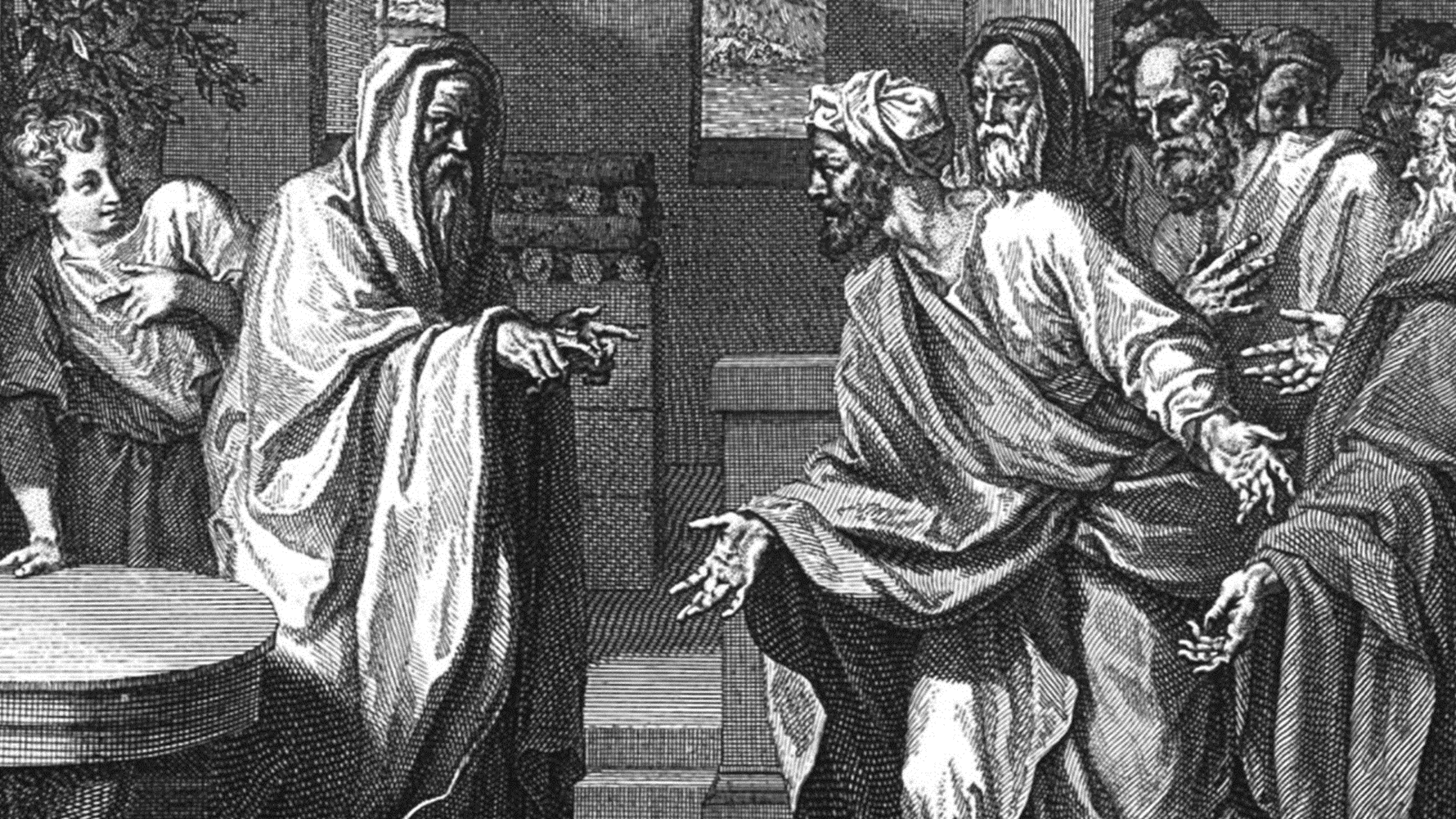
A determined rebellion.
Psalm 106:15 And he gave them their request; but sent leanness into their soul.
What do you do when the people you love keep lining up for stupid? Samuel prayed.

